Slide 1



stuck on a
gift?
Everything blue is a guide. Delete it before you download.
Notes:
Slide 1. Hook. Swap in a photo of your gift being wrapped.

Slide 2



[tired of giving
the usual?]
[try this instead]
Notes:
Slide 2. Second hook: Instagram often shows a carousel starting on slide 2, so this one works as a cover on its own. No photo needed. Edit both [bracket] lines.

Slide 3

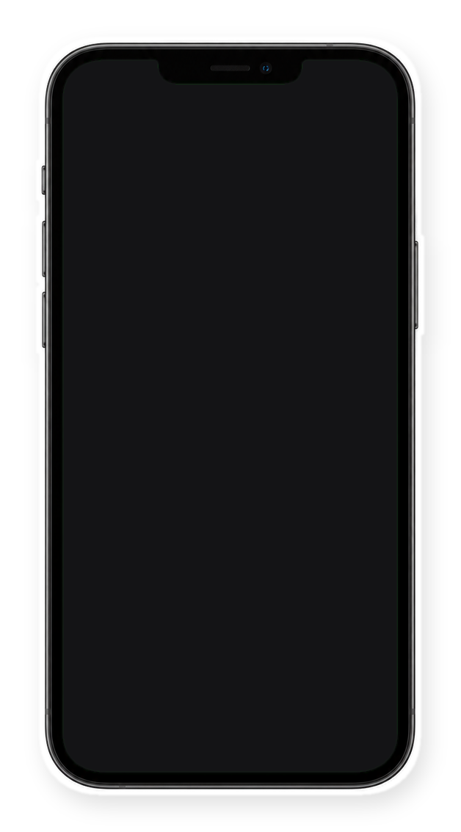

[found it.]
Notes:
Slide 3. Swap in a screenshot of your shop for the phone screen.

Slide 4



this one works for
all 3
Notes:
Slide 4. Swap in your product photo.

Slide 5


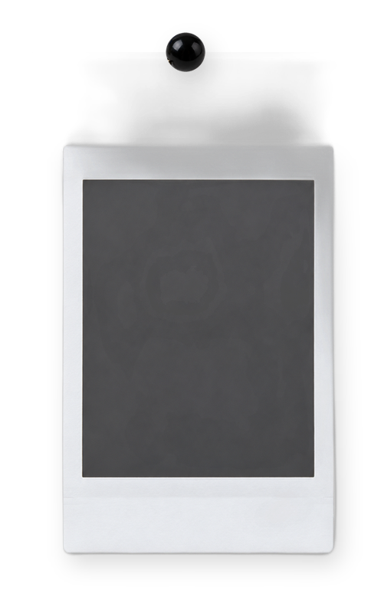


[3 people to
gift it to]
[your friend]
[your mum]
[your dad]
Notes:
Slide 5. Three people to gift it to: a photo and a name for each.

Slide 6

[gift wrap available]
Notes:
Slide 6. Edit the line (gift wrap, a note, whatever you offer).

Slide 7
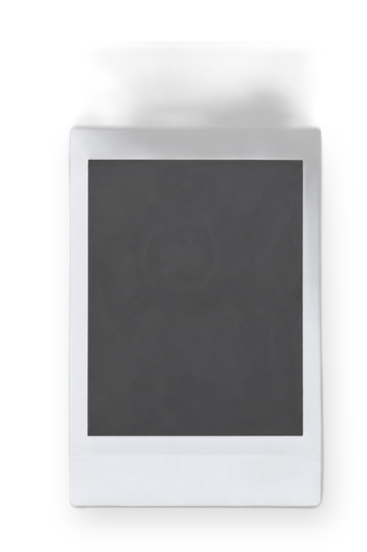


Comment
"[KEYWORD]"
Notes:
Slide 7. The same three photos. Type your keyword. Caption to start from (CTA in the first two sentences, 3 hashtags): Comment [KEYWORD] and I will send you [the link]. [One line of real context: who it helps or how you use it.] #[tag] #[tag] #[tag]

